Slide 1
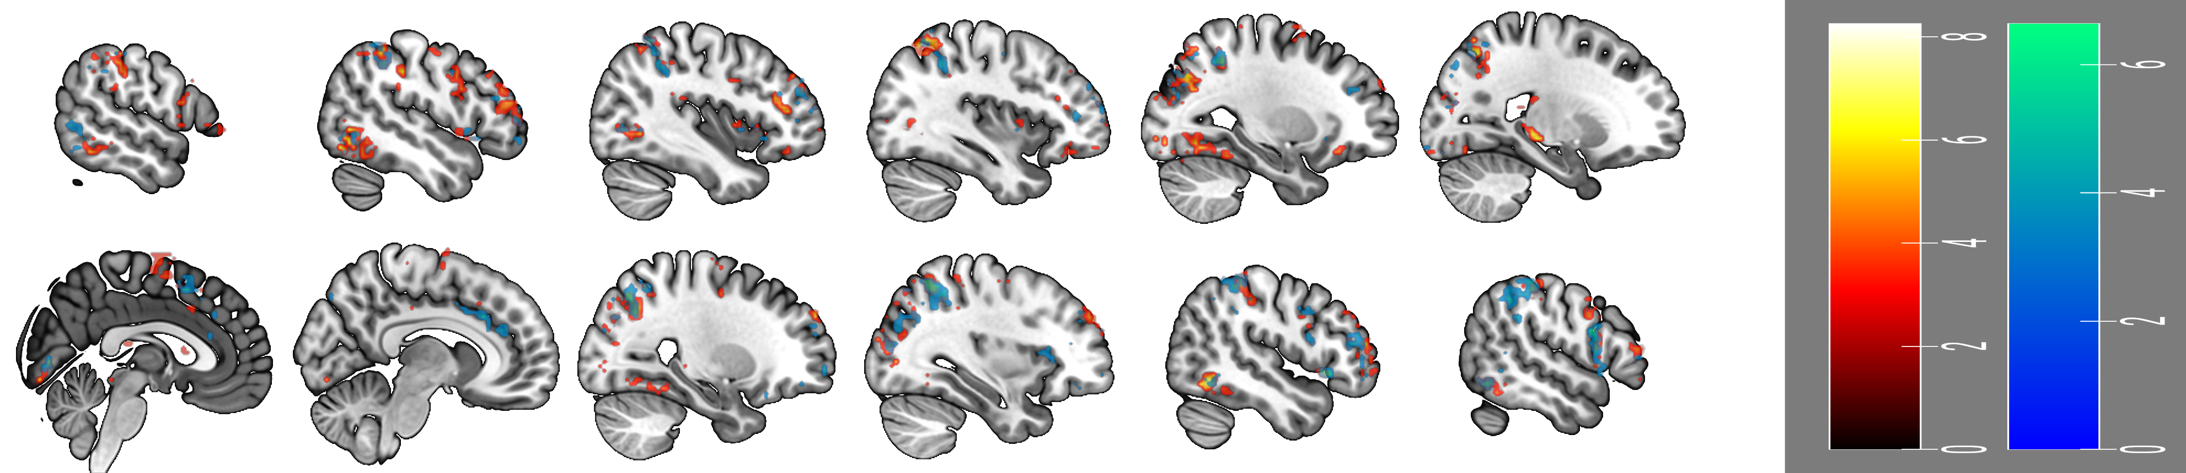
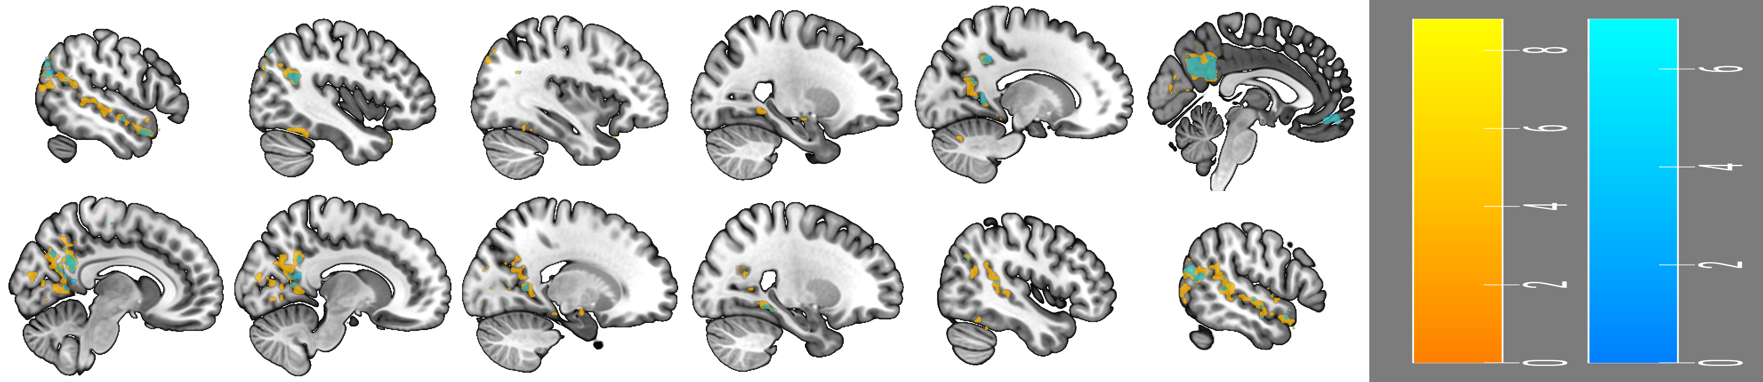
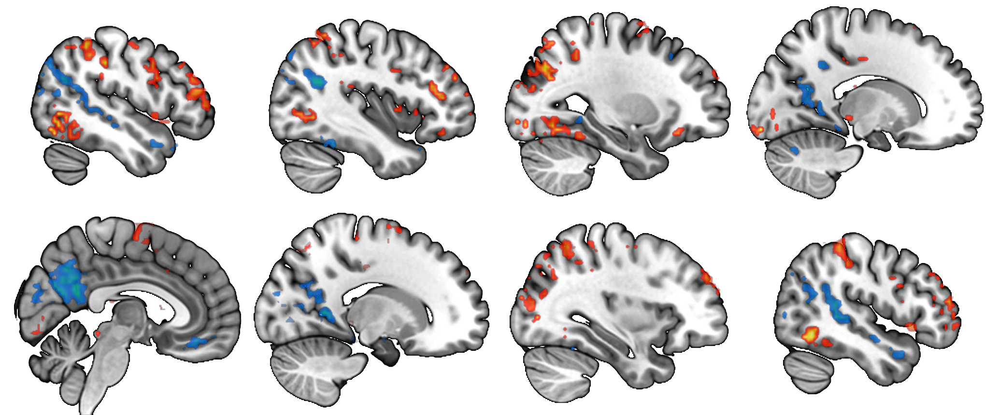
6.6
8.8
-49
-40
-28
-16
IPL
TPJ
dlPFC
PrCG
AG
IPL
IPS
ITL
STS
LING
ROL
AI
SMA
FFA
Occ
FFA
Cereb
Expr. Rating > Reflect. Not Rating
Reflect. Not Rating > Expr. Rating
pCUN
P
A
IPL
dlPFC
TPJ
CUN
IFG
LING
vmPFC
TP
FFA
+04
+16
+33
+47
0.0
0.0

